Slide 1
CURSO DEV FULL STACK:
Aula 07: Regressão Logística
SciKitLearning
Aplicação ao problema de previsão de empréstimo

Slide 2
Aprendizado de Máquina (machine learning):
Aprendizado de máquina é referido à criação e ao uso de modelos(regressão linear, regressão logística, redes neurais, etc.) que são aprendidos a partir dos dados.
O objetivo do ML é usar os dados existentes para desenvolver modelos que possamos usar para prever possíveis saídas para os dados novos.
Exemplificando:
Prever se uma mensagem de e-mail é spam ou não.
Prever se uma transação do cartão de crédito é fraudulenta.
Prever qual a probabilidade de um comprador clicar em uma propaganda.

Slide 3
REGRESSÃO LOGÍSTICA:
Método de machine learning usado para variáveis target categóricas (resultado binário).
Exemplo: Variável categórica
Previsão da diabetes (0 – não tem diabetes, 1 – tem diabetes)
Previsão se uma mensagem de e-mail é spam ou não( 0 – é spam, 1 – não é spam)

Slide 4
Função do 1º grau:
A função do 1º grau é dada por y=b0+b1.x
Dados os valores de y e x, temos que determinar os coeficientes b0 e b1.
y
x

Slide 5
O problema:
função linear: Y=b0+b1.x
Variáveis: x: nível e y: salário.
X:nível y:salário
3 5000
5 15000

Slide 6
Função do 1º grau:
Exemplo: Determinar a função y=b0+b1.x dados os pontos
Ponto 1: p1(x1=3,y1=5000)
Ponto 2: p2(x2=5, y2=1500) y
15
A partir da função determine:
5
Qual o salário (y) se o nível(x) for 4?
x
3 5

Slide 7
Função do 1º grau:
Exemplo: Determinar a função y=b0+b1.x dados os pontos
Ponto 1: p1(x1=3,y1=5000)
Ponto 2: p2(x2=5, y2=1500) y
15
A partir da função determine:
5
Qual o salário (y) se o nível(x) for 4?
x
3 5

Slide 8
Substituindo os valores:
A função é dada por: y=b0+b1.x
Ponto 1: p1(x1=3, y1=5000)
5000=b0+b1.3
Ponto 2: p2(x2=5, y2=15000)
15000=b0+b1.5

Slide 9
Sistema de equações:
Montando o sistema de equações:
b0+3.b1=5000
b0+5.b1=15000
Resolvendo o sistema de equações:
B0=-10000
B1=5000

Slide 10
Por fim, a Função:
A função do 1º grau é: Y= b0+b1.x
Y=-10000+5000.x
Determinando o que se pede. Qual o valor do salário (y) se o nível (x) for 4?
Y=-10000+5000.4
Y=-10000+20000
Y=10000
O salário de um programador nível 4 deve ser R$10mil.

Slide 11
O método da regressão logística:
Regressão Logística é um método usado para problemas em que a variável dependente (target variable) é do tipo binária.
Quanto às variáveis independentes, tanto podem ser categóricas ou numéricas.
A regressão logística é um método que nos permite estimar a probabilidade associada à ocorrência de determinado evento.

Slide 12
Exemplificando a regressão logística aplicada a previsão de empréstimo:
O problema de previsão de empréstimo.
Variáveis independentes:
Grau de instrução, salário, valor do empréstimo, tempo de pagamento, bens, etc.
Variável dependente:
- Status da solicitação.

Slide 13
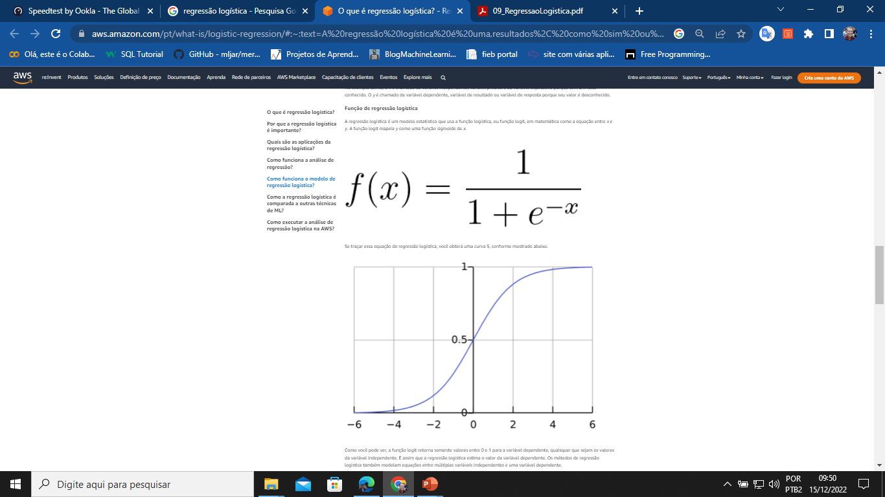
Função logística:

Slide 14
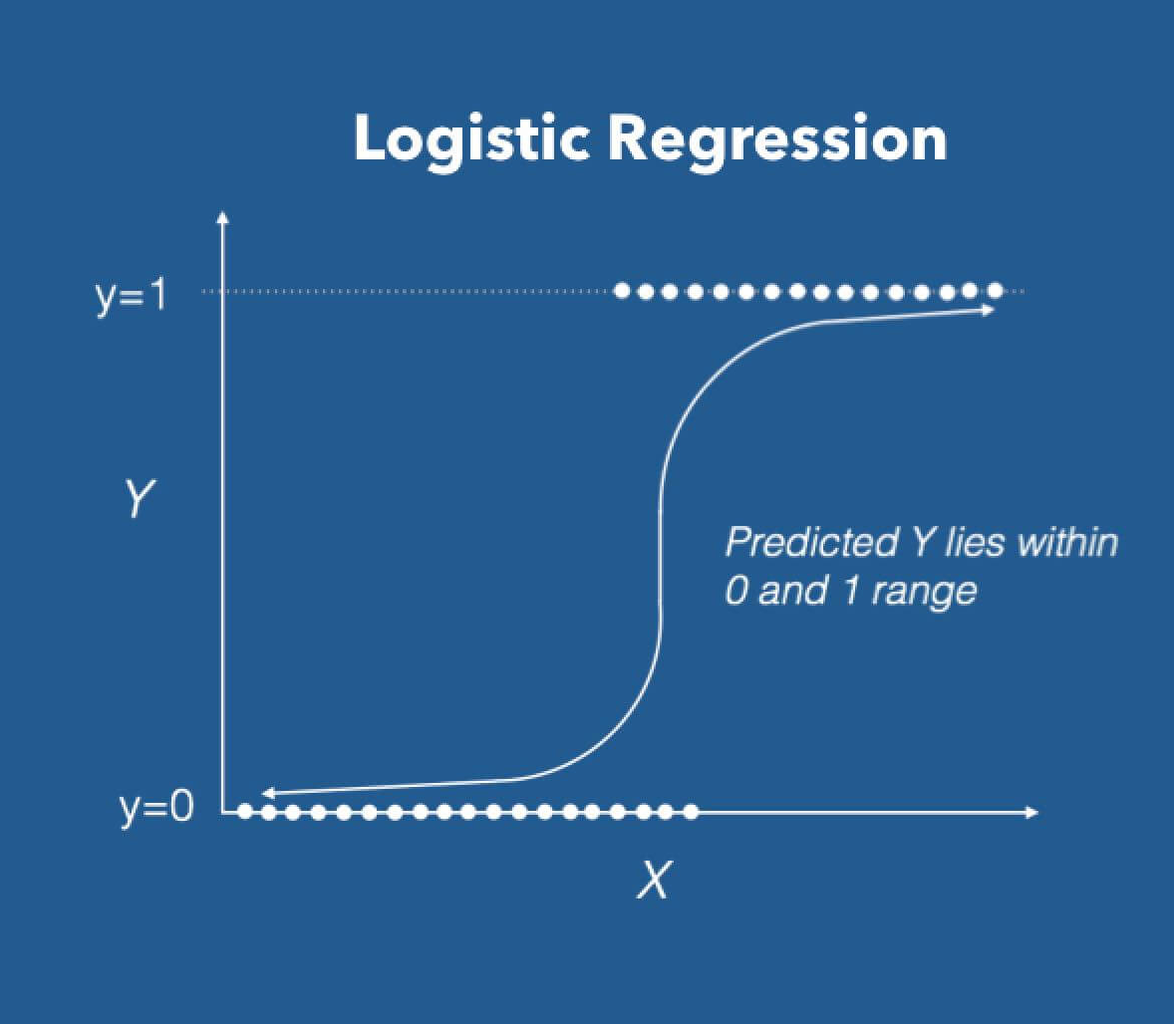

Slide 15
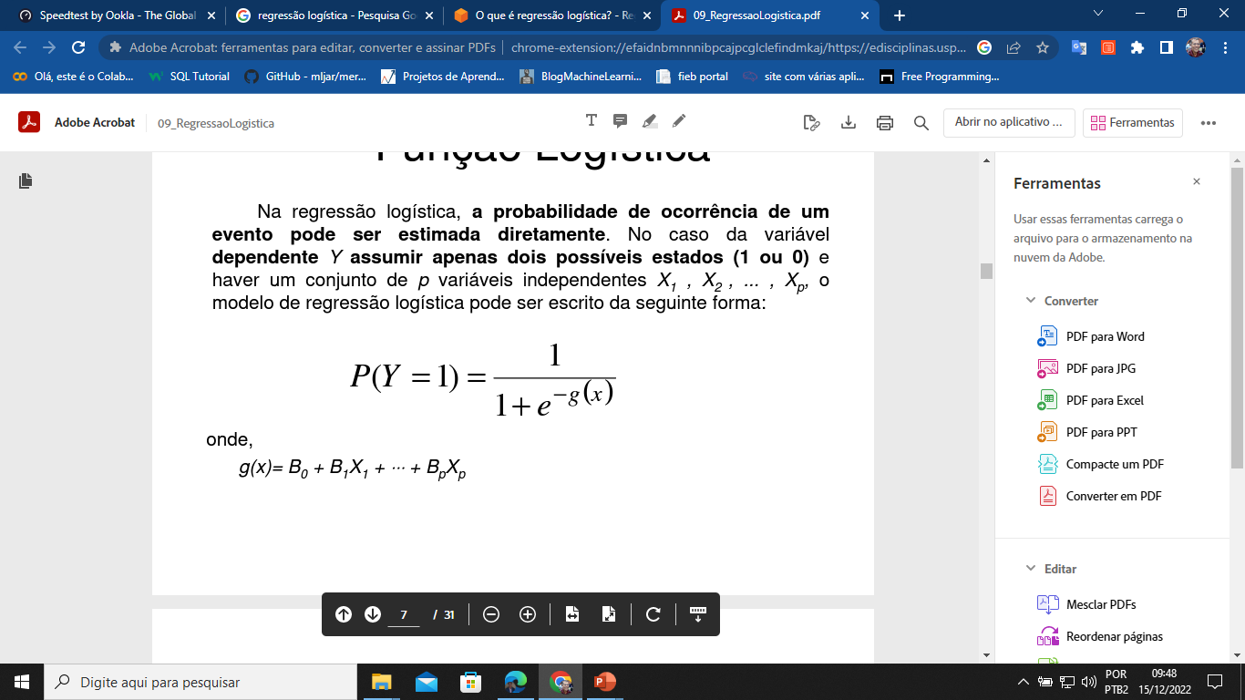
Regressão logística:
Na regressão logística, a probabilidade de ocorrência de um evento pode ser estimada diretamente.
A variável dependente Y assume apenas dois possíveis (1 ou 0).
Pode haver um conjunto de n variáveis independentes X1 , X2 , ... , Xn. mas só uma variável dependente y.
O modelo de regressão logística pode ser escrito da seguinte forma:

Slide 16
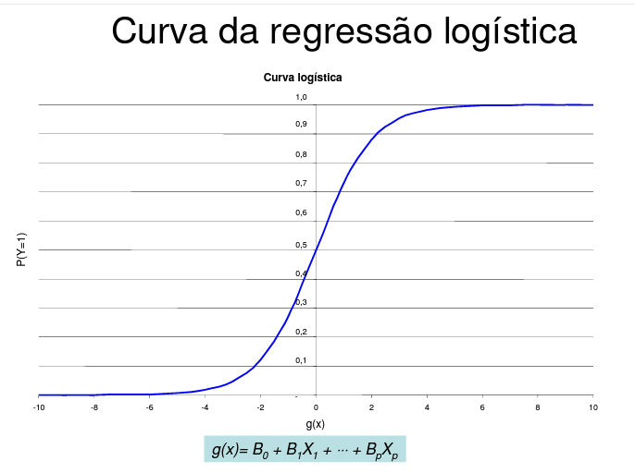

Slide 17
Exemplificando:
Problema de previsão de empréstimo simplificado:
Variáveis:
Salário (x1) valor do empréstimo(x2) status da solicitação(y)
1500 5000 1
2500 8000 0
4500 9000 1
Se um cliente com salário de 5500 pedir um empréstimo de 13000 o gerente vai aprovar ou reprovar a solicitação?

Slide 18
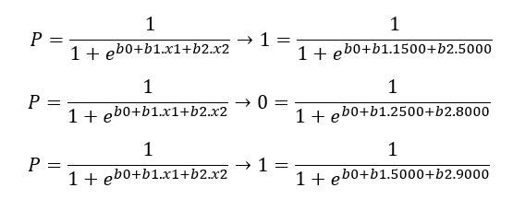
Aplicando os dados a função:
As probabilidades.
Y=B0+B1.x1+B2.x2
Ponto p1 (1500, 5000, 1)
1=b0+b1.1500+b2.5000
Ponto p2 (2500, 8000, 0)
0=b0+b1.2500+b2.8000
Ponto p3 (5000, 9000, 1)
1=b0+b1.5000+b2.9000

Slide 19
Montando o sistema de equações:
b0+b1.1500+b2.5000=1
b0+b1.2500+b2.800=0
b0+b1.5000+b2.9000=1

Slide 20
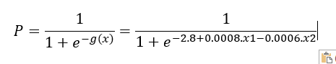
Resolvendo:
B0=2.8
B1=0.0008
B2=-0.0006
Assim a função logística fica: g(x)=2.8+0.0008.x1-0.0006.x2
A função probabilidade fica:

Slide 21
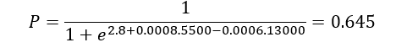
O que queremos saber?
Se um cliente com salário de 5500 pedir um empréstimo de 13000 o gerente vai aprovar ou reprovar a solicitação?

Slide 22
Scikit-learn.
Scikit-learn é considerado a biblioteca mais útil e robusta para aprendizado de máquina (Machine Learning) em Python.

Slide 23
Estrutura de um script de ML com o scikit-learn:
Escreva o dataframe.
. Identifique as variáveis predict (x1, x2, x3,..., xn).
. Identifique a variável target (y).
2. Defina a razão entre os conjuntos de treino e teste: 0.30 é o recomendado, ou seja, 70% do conjunto de dados é para o treino e 30% é para o teste.
3. Defina qual é o seu modelo (regressão linear, regressão logística, árvore de decisão, redes neurais).
4. Chame o fit do modelo.
5. Chame a métrica (qual grandeza mede a exatidão) do modelo.
6. Faça a predição do modelo.

Slide 24
Script python com o scikit-learn:
Modelo para regressão logística

Slide 25
Continuação do script:
# selecione o seu dataframe.
df = pd.read_csv(‘seu_nome_de_arquivo.csv’)
df.head()
df.info()

Slide 26
Selecionando as variáveis x e y:
#verifique as colunas e separe as variáveis.
df.columns
Vai imprimir:
Index(['Gender', 'Married', 'Dependents', 'Education', 'Self_Employed', 'ApplicantIncome', 'LoanAmount', 'Loan_Amount_Term', 'Credit_History', 'Property_Area', 'Loan_Status'], dtype='object')

Slide 27
Variáveis dependentes (x) e independente(y):
Variáveis dependentes (x):
x=df[['Gender','Married','Dependents','Education','Self_Employed','ApplicantIncome',
'LoanAmount','Loan_Amount_Term','Credit_History','Property_Area’]]
Variável independente (y):
y=df['Loan_Status']

Slide 28
Criando os conjuntos de dados de treino e teste:
import sklearn
from sklearn.model_selection import train_test_split
x_treinamento, x_teste, y_treinamento, y_teste = train_test_split(x, y, test_size = 0.3)

Slide 29
Criando o modelo:
from sklearn.linear_model import LogisticRegression
L_R = LogisticRegression()
L_R.fit(x_treinamento, y_treinamento)

Slide 30
Previsões com o conjunto de teste:
y_previsoes = L_R.predict(x_teste)

Slide 31
Definindo a métrica:
from sklearn import metrics
from sklearn.metrics import accuracy_score
y_predicao =L_R.predict(x_teste)
acuracia = accuracy_score(y_teste, y_predicao) * 100
print ("A acurácia na média para o conjunto de 184 dados foi de {:.2f}%.".format(acuracia))
print (f"A acurácia na média para o conjunto de 184 dados foi de {acuracia:.2f}")

Slide 32
Fazendo novas provisões:
new_client1 = [[0.0,0.0,0.0,1.0,0.0,0.58,0.61,0.74,1.0,1.0]]
new_client2 = [[0.0,1.0,0.33,1.0,0.0,0.54,0.60,0.74,0.0,0.0]]
Faz_Prev = L_R.predict(new_client1)
Prob=L_R.predict_proba(new_client1)
if Faz_Prev==0:
print('Empréstimo Negado, probabilidade de ',Prob*100)
else:
print('Empréstimo Concedido, probabilidade de ',Prob*100)

Slide 33
dados
Gender,Married,Dependents,Education,Self_Employed,ApplicantIncome,LoanAmount,Loan_Amount_Term,Credit_History,Property_Area,Loan_Status0.0,0.0,0.0,1,0.0,5849,128.0,360.0,1.0,2,10.0,1.0,1.0,1,0.0,4583,128.0,360.0,1.0,0,00.0,1.0,0.0,1,1.0,3000,66.0,360.0,1.0,2,10.0,1.0,0.0,0,0.0,2583,120.0,360.0,1.0,2,10.0,0.0,0.0,1,0.0,6000,141.0,360.0,1.0,2,10.0,1.0,2.0,1,1.0,5417,267.0,360.0,1.0,2,10.0,1.0,0.0,0,0.0,2333,95.0,360.0,1.0,2,10.0,1.0,3.0,1,0.0,3036,158.0,360.0,0.0,1,00.0,1.0,2.0,1,0.0,4006,168.0,360.0,1.0,2,10.0,1.0,1.0,1,0.0,12841,349.0,360.0,1.0,1,00.0,1.0,2.0,1,0.0,3200,70.0,360.0,1.0,2,10.0,1.0,2.0,1,0.0,2500,109.0,360.0,1.0,2,10.0,1.0,2.0,1,0.0,3073,200.0,360.0,1.0,2,10.0,0.0,0.0,1,0.0,1853,114.0,360.0,1.0,0,00.0,1.0,2.0,1,0.0,1299,17.0,120.0,1.0,2,10.0,0.0,0.0,1,0.0,4950,125.0,360.0,1.0,2,10.0,0.0,1.0,0,0.0,3596,100.0,240.0,1.0,2,11.0,0.0,0.0,1,0.0,3510,76.0,360.0,0.0,2,00.0,1.0,0.0,0,0.0,4887,133.0,360.0,1.0,0,00.0,1.0,0.0,1,0.0,2600,115.0,360.0,1.0,2,10.0,1.0,0.0,0,0.0,7660,104.0,360.0,0.0,2,00.0,1.0,1.0,1,0.0,5955,315.0,360.0,1.0,2,10.0,1.0,0.0,0,0.0,2600,116.0,360.0,0.0,1,00.0,1.0,2.0,0,0.0,3365,112.0,360.0,0.0,0,00.0,1.0,1.0,1,0.0,3717,151.0,360.0,1.0,1,00.0,1.0,0.0,1,1.0,9560,191.0,360.0,1.0,1,10.0,1.0,0.0,1,0.0,2799,122.0,360.0,1.0,1,10.0,1.0,2.0,0,0.0,4226,110.0,360.0,1.0,2,10.0,0.0,0.0,0,0.0,1442,35.0,360.0,1.0,2,01.0,0.0,2.0,1,0.0,3750,120.0,360.0,1.0,1,10.0,1.0,1.0,1,0.0,4166,201.0,360.0,1.0,2,00.0,0.0,0.0,1,0.0,3167,74.0,360.0,1.0,2,00.0,0.0,1.0,1,1.0,4692,106.0,360.0,1.0,0,00.0,1.0,0.0,1,0.0,3500,114.0,360.0,1.0,1,10.0,0.0,3.0,1,0.0,12500,320.0,360.0,1.0,0,00.0,1.0,0.0,1,0.0,2275,128.0,360.0,1.0,2,10.0,1.0,0.0,1,0.0,1828,100.0,360.0,0.0,2,01.0,1.0,0.0,1,0.0,3667,144.0,360.0,1.0,1,10.0,0.0,0.0,1,0.0,4166,184.0,360.0,1.0,2,10.0,0.0,0.0,0,0.0,3748,110.0,360.0,1.0,1,10.0,0.0,0.0,1,0.0,3600,80.0,360.0,1.0,2,00.0,0.0,0.0,1,0.0,1800,47.0,360.0,1.0,2,10.0,1.0,0.0,1,0.0,2400,75.0,360.0,1.0,2,10.0,1.0,0.0,1,0.0,3941,134.0,360.0,1.0,1,10.0,1.0,0.0,0,1.0,4695,96.0,360.0,1.0,2,11.0,0.0,0.0,1,0.0,3410,88.0,360.0,1.0,2,10.0,1.0,1.0,1,0.0,5649,44.0,360.0,1.0,2,10.0,1.0,0.0,1,0.0,5821,144.0,360.0,1.0,2,11.0,1.0,0.0,1,0.0,2645,120.0,360.0,0.0,2,01.0,0.0,0.0,1,0.0,4000,144.0,360.0,1.0,1,11.0,1.0,0.0,0,0.0,1928,100.0,360.0,1.0,1,11.0,0.0,0.0,1,0.0,3086,120.0,360.0,1.0,1,11.0,0.0,0.0,1,0.0,4230,112.0,360.0,1.0,1,00.0,1.0,2.0,1,0.0,4616,134.0,360.0,1.0,2,01.0,1.0,1.0,1,1.0,11500,286.0,360.0,0.0,2,00.0,1.0,2.0,1,0.0,2708,97.0,360.0,1.0,1,10.0,1.0,0.0,1,0.0,2132,96.0,360.0,1.0,1,10.0,1.0,0.0,1,0.0,3366,135.0,360.0,1.0,0,00.0,1.0,1.0,1,0.0,8080,180.0,360.0,1.0,2,10.0,1.0,2.0,0,0.0,3357,144.0,360.0,1.0,2,10.0,1.0,0.0,1,0.0,2500,120.0,360.0,1.0,2,10.0,1.0,3.0,1,0.0,3029,99.0,360.0,1.0,2,10.0,1.0,0.0,0,1.0,2609,165.0,180.0,0.0,0,00.0,1.0,1.0,1,0.0,4945,128.0,360.0,0.0,0,01.0,0.0,0.0,1,0.0,4166,116.0,360.0,0.0,1,00.0,1.0,0.0,1,0.0,5726,258.0,360.0,1.0,1,00.0,0.0,0.0,0,0.0,3200,126.0,180.0,0.0,2,00.0,1.0,1.0,1,0.0,10750,312.0,360.0,1.0,2,10.0,1.0,3.0,0,1.0,7100,125.0,60.0,1.0,2,11.0,0.0,0.0,1,0.0,4300,136.0,360.0,0.0,1,00.0,1.0,0.0,1,0.0,3208,172.0,360.0,1.0,2,10.0,1.0,2.0,0,1.0,1875,97.0,360.0,1.0,1,10.0,0.0,0.0,1,0.0,3500,81.0,300.0,1.0,1,10.0,1.0,3.0,0,0.0,4755,95.0,360.0,0.0,1,00.0,1.0,3.0,1,1.0,5266,187.0,360.0,1.0,1,10.0,0.0,0.0,1,0.0,3750,113.0,480.0,1.0,2,00.0,0.0,0.0,1,0.0,3750,176.0,360.0,1.0,2,00.0,1.0,1.0,1,1.0,1000,110.0,360.0,1.0,2,00.0,1.0,3.0,1,0.0,3167,180.0,300.0,0.0,1,00.0,1.0,3.0,0,1.0,3333,130.0,360.0,1.0,1,11.0,0.0,0.0,1,0.0,3846,111.0,360.0,1.0,1,10.0,1.0,1.0,1,1.0,2395,128.0,360.0,1.0,1,11.0,1.0,2.0,1,0.0,1378,167.0,360.0,1.0,2,00.0,1.0,0.0,1,0.0,6000,265.0,360.0,1.0,1,00.0,1.0,1.0,1,0.0,3988,50.0,240.0,1.0,2,10.0,0.0,0.0,1,0.0,2366,136.0,360.0,1.0,1,10.0,1.0,2.0,0,0.0,3333,99.0,360.0,1.0,1,10.0,1.0,0.0,1,0.0,2500,104.0,360.0,1.0,1,10.0,0.0,0.0,1,0.0,8566,210.0,360.0,1.0,2,10.0,1.0,0.0,1,0.0,5695,175.0,360.0,1.0,1,10.0,1.0,0.0,1,0.0,2958,131.0,360.0,1.0,1,10.0,1.0,2.0,1,0.0,6250,188.0,180.0,1.0,1,10.0,1.0,2.0,0,0.0,3273,81.0,360.0,1.0,2,10.0,0.0,0.0,1,0.0,4133,122.0,360.0,1.0,1,10.0,0.0,0.0,0,0.0,3620,25.0,120.0,1.0,1,10.0,0.0,0.0,1,0.0,6782,128.0,360.0,1.0,2,01.0,1.0,0.0,1,0.0,2484,137.0,360.0,1.0,1,10.0,1.0,0.0,1,0.0,1977,50.0,360.0,1.0,1,10.0,1.0,0.0,0,0.0,4188,115.0,180.0,1.0,1,10.0,1.0,0.0,1,0.0,1759,131.0,360.0,1.0,1,10.0,1.0,2.0,0,0.0,4288,133.0,180.0,1.0,2,10.0,0.0,0.0,1,0.0,4843,151.0,360.0,1.0,1,10.0,1.0,0.0,1,0.0,13650,128.0,360.0,1.0,2,10.0,1.0,0.0,1,0.0,4652,128.0,360.0,1.0,1,10.0,1.0,0.0,1,0.0,3816,160.0,360.0,1.0,2,10.0,1.0,1.0,1,0.0,3052,100.0,360.0,1.0,2,10.0,1.0,2.0,1,0.0,11417,225.0,360.0,1.0,2,10.0,0.0,0.0,0,0.0,7333,120.0,360.0,1.0,0,00.0,1.0,2.0,1,0.0,3800,216.0,360.0,0.0,2,00.0,1.0,3.0,0,0.0,2071,94.0,480.0,1.0,1,10.0,0.0,0.0,1,0.0,5316,136.0,360.0,1.0,2,11.0,1.0,0.0,1,0.0,2929,139.0,360.0,1.0,1,10.0,1.0,0.0,0,0.0,3572,152.0,360.0,0.0,0,01.0,0.0,1.0,1,1.0,7451,128.0,360.0,1.0,1,10.0,0.0,0.0,1,0.0,5050,118.0,360.0,1.0,1,10.0,1.0,1.0,1,0.0,14583,185.0,180.0,1.0,0,11.0,1.0,0.0,1,0.0,3167,154.0,360.0,1.0,1,10.0,1.0,1.0,1,0.0,2214,85.0,360.0,1.0,2,10.0,1.0,0.0,1,0.0,5568,175.0,360.0,1.0,0,01.0,0.0,0.0,1,0.0,10408,259.0,360.0,1.0,2,10.0,1.0,0.0,1,0.0,5667,180.0,360.0,1.0,0,11.0,0.0,0.0,1,0.0,4166,44.0,360.0,1.0,1,11.0,0.0,0.0,1,0.0,2137,137.0,360.0,0.0,1,10.0,1.0,2.0,1,0.0,2957,81.0,360.0,1.0,1,10.0,1.0,0.0,0,0.0,4300,194.0,360.0,1.0,0,11.0,0.0,0.0,1,0.0,3692,93.0,360.0,1.0,0,10.0,1.0,3.0,1,0.0,23803,370.0,360.0,1.0,0,10.0,0.0,0.0,1,0.0,3865,128.0,360.0,1.0,0,10.0,1.0,1.0,1,1.0,10513,160.0,180.0,0.0,2,00.0,1.0,0.0,1,0.0,6080,182.0,360.0,1.0,0,00.0,0.0,0.0,1,1.0,20166,650.0,480.0,1.0,2,10.0,0.0,0.0,1,0.0,2014,74.0,360.0,1.0,2,10.0,0.0,0.0,1,0.0,2718,70.0,360.0,1.0,1,10.0,1.0,0.0,1,1.0,3459,25.0,120.0,1.0,1,10.0,0.0,0.0,1,0.0,4895,102.0,360.0,1.0,1,10.0,1.0,3.0,1,0.0,4000,290.0,360.0,1.0,1,01.0,1.0,0.0,1,0.0,4583,84.0,360.0,1.0,0,00.0,1.0,2.0,1,1.0,3316,88.0,360.0,1.0,2,10.0,0.0,0.0,1,0.0,14999,242.0,360.0,0.0,1,00.0,1.0,2.0,0,0.0,4200,129.0,360.0,1.0,0,00.0,1.0,2.0,1,0.0,5042,185.0,360.0,1.0,0,00.0,0.0,0.0,1,0.0,5417,168.0,360.0,1.0,2,10.0,0.0,0.0,1,1.0,6950,175.0,180.0,1.0,1,10.0,1.0,0.0,1,0.0,2698,122.0,360.0,1.0,1,10.0,1.0,2.0,1,0.0,11757,187.0,180.0,1.0,2,11.0,1.0,0.0,1,0.0,2330,100.0,360.0,1.0,1,11.0,1.0,2.0,1,0.0,14866,70.0,360.0,1.0,2,10.0,1.0,1.0,1,0.0,1538,30.0,360.0,1.0,2,11.0,0.0,0.0,1,0.0,10000,225.0,360.0,1.0,0,00.0,1.0,0.0,1,0.0,4860,125.0,360.0,1.0,1,10.0,0.0,0.0,1,0.0,6277,118.0,360.0,0.0,0,00.0,1.0,0.0,1,1.0,2577,152.0,360.0,1.0,0,10.0,0.0,0.0,1,0.0,9166,244.0,360.0,1.0,2,00.0,1.0,2.0,0,0.0,2281,113.0,360.0,1.0,0,00.0,0.0,0.0,1,0.0,3254,50.0,360.0,1.0,2,10.0,1.0,3.0,1,0.0,39999,600.0,180.0,0.0,1,10.0,1.0,1.0,1,0.0,6000,160.0,360.0,1.0,0,10.0,1.0,1.0,1,0.0,9538,187.0,360.0,1.0,2,10.0,0.0,0.0,1,0.0,2980,120.0,360.0,1.0,0,10.0,1.0,0.0,1,0.0,4583,255.0,360.0,1.0,1,10.0,1.0,0.0,0,0.0,1863,98.0,360.0,1.0,1,10.0,1.0,0.0,1,0.0,7933,275.0,360.0,1.0,2,00.0,1.0,1.0,1,0.0,3089,121.0,360.0,0.0,1,00.0,1.0,2.0,1,0.0,4167,158.0,360.0,1.0,0,10.0,1.0,0.0,1,0.0,9323,75.0,180.0,1.0,2,10.0,1.0,0.0,1,0.0,3707,182.0,360.0,1.0,0,11.0,1.0,0.0,1,0.0,4583,112.0,360.0,1.0,0,00.0,1.0,0.0,1,0.0,2439,129.0,360.0,1.0,0,10.0,0.0,0.0,1,0.0,2237,63.0,480.0,0.0,1,00.0,1.0,2.0,1,0.0,8000,200.0,360.0,1.0,1,10.0,1.0,0.0,0,0.0,1820,95.0,360.0,1.0,0,10.0,1.0,3.0,1,0.0,51763,700.0,300.0,1.0,2,10.0,1.0,3.0,0,0.0,3522,81.0,180.0,1.0,0,00.0,1.0,0.0,1,0.0,5708,187.0,360.0,1.0,1,10.0,1.0,0.0,0,1.0,4344,87.0,360.0,1.0,1,00.0,1.0,0.0,1,0.0,3497,116.0,360.0,1.0,0,10.0,1.0,2.0,1,0.0,2045,101.0,360.0,1.0,0,10.0,1.0,3.0,1,0.0,5516,495.0,360.0,0.0,1,00.0,1.0,1.0,1,0.0,3750,116.0,360.0,1.0,1,10.0,0.0,0.0,0,0.0,2333,102.0,480.0,0.0,2,00.0,1.0,1.0,1,0.0,6400,180.0,360.0,0.0,2,00.0,0.0,0.0,1,0.0,1916,67.0,360.0,1.0,0,00.0,1.0,0.0,1,0.0,4600,73.0,180.0,1.0,1,10.0,1.0,1.0,1,0.0,33846,260.0,360.0,1.0,1,01.0,1.0,0.0,1,0.0,3625,108.0,360.0,1.0,1,10.0,1.0,0.0,1,1.0,39147,120.0,360.0,1.0,1,10.0,1.0,1.0,1,1.0,2178,66.0,300.0,0.0,0,00.0,1.0,0.0,1,0.0,2383,58.0,360.0,1.0,0,10.0,1.0,0.0,1,1.0,674,168.0,360.0,1.0,0,10.0,1.0,0.0,1,0.0,9328,188.0,180.0,1.0,0,10.0,0.0,0.0,0,0.0,4885,48.0,360.0,1.0,0,10.0,0.0,0.0,1,0.0,12000,164.0,360.0,1.0,1,00.0,1.0,0.0,0,0.0,6033,160.0,360.0,1.0,2,00.0,0.0,0.0,1,0.0,3858,76.0,360.0,1.0,1,10.0,0.0,0.0,1,0.0,4191,120.0,360.0,1.0,0,10.0,1.0,1.0,1,0.0,3125,170.0,360.0,1.0,1,00.0,0.0,0.0,1,0.0,8333,187.0,360.0,1.0,0,11.0,0.0,0.0,0,0.0,1907,120.0,360.0,1.0,2,11.0,1.0,0.0,1,0.0,3416,113.0,360.0,1.0,1,10.0,0.0,0.0,1,1.0,11000,83.0,360.0,1.0,2,00.0,1.0,1.0,0,0.0,2600,90.0,360.0,1.0,1,10.0,0.0,2.0,1,0.0,4923,166.0,360.0,0.0,1,10.0,1.0,3.0,0,0.0,3992,128.0,180.0,1.0,2,00.0,1.0,1.0,0,0.0,3500,135.0,360.0,1.0,2,10.0,1.0,2.0,0,0.0,3917,124.0,360.0,1.0,1,11.0,0.0,0.0,0,0.0,4408,120.0,360.0,1.0,1,11.0,0.0,0.0,1,0.0,3244,80.0,360.0,1.0,2,10.0,0.0,0.0,0,0.0,3975,55.0,360.0,1.0,0,10.0,0.0,0.0,1,0.0,2479,59.0,360.0,1.0,2,10.0,0.0,0.0,1,0.0,3418,127.0,360.0,1.0,1,01.0,0.0,0.0,1,0.0,10000,214.0,360.0,1.0,1,00.0,1.0,3.0,1,0.0,3430,128.0,360.0,0.0,1,00.0,1.0,1.0,1,1.0,7787,240.0,360.0,1.0,2,10.0,1.0,3.0,0,1.0,5703,130.0,360.0,1.0,0,10.0,1.0,0.0,1,0.0,3173,137.0,360.0,1.0,2,10.0,1.0,3.0,0,0.0,3850,100.0,360.0,1.0,1,10.0,1.0,0.0,1,0.0,150,135.0,360.0,1.0,0,00.0,1.0,0.0,1,0.0,3727,131.0,360.0,1.0,1,10.0,1.0,2.0,1,0.0,5000,72.0,360.0,0.0,1,01.0,1.0,2.0,1,0.0,4283,127.0,360.0,1.0,1,10.0,1.0,0.0,1,0.0,2221,60.0,360.0,0.0,2,00.0,1.0,2.0,1,0.0,4009,116.0,360.0,1.0,1,10.0,0.0,0.0,1,0.0,2971,144.0,360.0,1.0,1,10.0,1.0,0.0,1,0.0,7578,175.0,360.0,1.0,1,10.0,1.0,0.0,1,0.0,6250,128.0,360.0,1.0,1,10.0,1.0,0.0,1,0.0,3250,170.0,360.0,1.0,0,00.0,1.0,0.0,0,1.0,4735,138.0,360.0,1.0,2,00.0,1.0,2.0,1,0.0,6250,210.0,360.0,1.0,1,10.0,1.0,0.0,1,0.0,4758,158.0,480.0,1.0,1,10.0,0.0,0.0,1,1.0,6400,200.0,360.0,1.0,0,10.0,1.0,1.0,1,0.0,2491,104.0,360.0,1.0,1,10.0,1.0,0.0,1,0.0,3716,42.0,180.0,1.0,0,10.0,0.0,0.0,0,0.0,3189,120.0,360.0,1.0,0,11.0,0.0,0.0,1,0.0,8333,280.0,360.0,1.0,1,10.0,1.0,1.0,1,0.0,3155,140.0,360.0,1.0,1,10.0,1.0,1.0,1,0.0,5500,170.0,360.0,1.0,0,10.0,1.0,0.0,1,0.0,5746,255.0,360.0,1.0,2,01.0,0.0,0.0,1,1.0,3463,122.0,360.0,1.0,2,11.0,0.0,1.0,1,0.0,3812,112.0,360.0,1.0,0,10.0,1.0,1.0,1,0.0,3315,96.0,360.0,1.0,1,10.0,1.0,2.0,1,0.0,5819,120.0,360.0,1.0,0,10.0,1.0,1.0,0,0.0,2510,140.0,180.0,1.0,2,00.0,0.0,0.0,1,0.0,2965,155.0,60.0,1.0,2,10.0,1.0,2.0,1,1.0,6250,108.0,360.0,1.0,0,10.0,1.0,0.0,0,0.0,3406,123.0,360.0,1.0,1,10.0,0.0,0.0,1,1.0,6050,120.0,180.0,1.0,2,00.0,1.0,2.0,1,0.0,9703,112.0,360.0,1.0,2,10.0,1.0,1.0,0,0.0,6608,137.0,180.0,1.0,2,10.0,1.0,1.0,1,0.0,2882,123.0,480.0,1.0,1,10.0,1.0,0.0,1,0.0,1809,90.0,360.0,1.0,2,10.0,1.0,0.0,0,0.0,1668,201.0,360.0,0.0,1,01.0,0.0,2.0,1,0.0,3427,138.0,360.0,1.0,2,00.0,0.0,0.0,0,1.0,2583,104.0,360.0,1.0,0,10.0,1.0,1.0,0,0.0,2661,279.0,180.0,1.0,1,10.0,0.0,0.0,1,1.0,16250,192.0,360.0,0.0,2,01.0,0.0,3.0,1,0.0,3083,255.0,360.0,1.0,0,10.0,0.0,0.0,0,0.0,6045,115.0,360.0,0.0,0,00.0,1.0,3.0,1,0.0,5250,94.0,360.0,1.0,2,00.0,1.0,0.0,1,0.0,14683,304.0,360.0,1.0,0,00.0,1.0,3.0,0,0.0,4931,128.0,360.0,1.0,1,00.0,1.0,1.0,1,0.0,6083,330.0,360.0,1.0,2,10.0,0.0,0.0,1,0.0,2060,134.0,360.0,1.0,1,11.0,0.0,1.0,1,0.0,3481,155.0,36.0,1.0,1,01.0,0.0,0.0,1,0.0,7200,120.0,360.0,1.0,0,10.0,0.0,0.0,1,1.0,5166,128.0,360.0,1.0,1,10.0,0.0,0.0,1,0.0,4095,151.0,360.0,1.0,0,10.0,1.0,2.0,1,0.0,4708,150.0,360.0,1.0,1,10.0,1.0,3.0,1,0.0,4333,160.0,360.0,0.0,2,11.0,0.0,0.0,1,0.0,3418,135.0,360.0,1.0,0,01.0,0.0,1.0,1,0.0,2876,90.0,360.0,1.0,2,11.0,0.0,0.0,1,0.0,3237,30.0,360.0,1.0,2,10.0,1.0,0.0,1,0.0,11146,136.0,360.0,1.0,2,10.0,0.0,0.0,1,0.0,2833,126.0,360.0,1.0,0,10.0,1.0,0.0,1,0.0,2620,150.0,360.0,1.0,1,10.0,1.0,2.0,1,0.0,3900,90.0,360.0,1.0,1,10.0,1.0,1.0,1,0.0,2750,115.0,360.0,1.0,1,10.0,1.0,0.0,1,0.0,3993,207.0,360.0,1.0,1,10.0,1.0,0.0,1,0.0,3103,80.0,360.0,1.0,2,10.0,1.0,0.0,1,0.0,14583,436.0,360.0,1.0,1,11.0,1.0,0.0,0,0.0,4100,124.0,360.0,1.0,0,10.0,0.0,1.0,0,1.0,4053,158.0,360.0,0.0,2,00.0,1.0,0.0,1,0.0,3927,112.0,360.0,1.0,1,10.0,1.0,2.0,1,0.0,2301,78.0,180.0,1.0,2,11.0,0.0,0.0,1,0.0,1811,54.0,360.0,1.0,2,10.0,1.0,0.0,1,0.0,20667,128.0,360.0,1.0,0,00.0,0.0,0.0,1,0.0,3158,89.0,360.0,1.0,0,11.0,0.0,0.0,1,1.0,2600,99.0,300.0,1.0,1,00.0,1.0,0.0,1,0.0,3704,120.0,360.0,1.0,0,11.0,0.0,0.0,1,0.0,4124,115.0,360.0,1.0,1,10.0,0.0,0.0,1,0.0,9508,187.0,360.0,1.0,0,10.0,1.0,0.0,1,0.0,3075,139.0,360.0,1.0,0,10.0,1.0,2.0,1,0.0,4400,127.0,360.0,0.0,1,00.0,1.0,2.0,1,0.0,3153,134.0,360.0,1.0,2,11.0,0.0,0.0,1,0.0,5417,143.0,480.0,0.0,2,00.0,1.0,0.0,1,0.0,2383,172.0,360.0,1.0,1,10.0,1.0,3.0,1,0.0,4416,110.0,360.0,1.0,2,10.0,1.0,1.0,1,0.0,6875,200.0,360.0,1.0,1,11.0,1.0,1.0,1,0.0,4666,135.0,360.0,1.0,2,11.0,0.0,0.0,1,0.0,5000,151.0,480.0,1.0,0,00.0,1.0,1.0,1,0.0,2014,113.0,360.0,1.0,2,00.0,1.0,0.0,0,0.0,1800,93.0,360.0,0.0,2,00.0,1.0,0.0,0,0.0,2875,105.0,360.0,1.0,1,11.0,0.0,0.0,1,0.0,5000,132.0,360.0,1.0,0,10.0,1.0,1.0,1,0.0,1625,96.0,360.0,1.0,2,10.0,0.0,0.0,1,0.0,4000,140.0,360.0,1.0,0,10.0,0.0,0.0,0,0.0,2000,128.0,360.0,1.0,2,01.0,0.0,0.0,1,0.0,3762,135.0,360.0,1.0,0,11.0,0.0,0.0,1,0.0,2400,104.0,360.0,0.0,2,00.0,0.0,0.0,1,0.0,20233,480.0,360.0,1.0,0,00.0,1.0,2.0,0,0.0,7667,185.0,360.0,1.0,0,11.0,0.0,0.0,1,0.0,2917,84.0,360.0,1.0,1,10.0,0.0,0.0,0,0.0,2927,111.0,360.0,1.0,1,11.0,0.0,0.0,1,0.0,2507,56.0,360.0,1.0,0,10.0,1.0,2.0,1,1.0,5746,144.0,84.0,1.0,0,10.0,1.0,0.0,1,0.0,2473,159.0,360.0,1.0,0,00.0,1.0,1.0,0,0.0,3399,111.0,180.0,1.0,2,10.0,1.0,2.0,1,0.0,3717,120.0,360.0,1.0,1,10.0,1.0,0.0,1,0.0,2058,88.0,360.0,1.0,2,11.0,0.0,1.0,1,0.0,3541,112.0,360.0,1.0,1,10.0,1.0,1.0,1,1.0,10000,155.0,360.0,1.0,0,00.0,1.0,0.0,1,0.0,2400,115.0,360.0,1.0,1,10.0,1.0,3.0,1,0.0,4342,124.0,360.0,1.0,1,10.0,1.0,2.0,0,0.0,3601,128.0,360.0,1.0,0,11.0,0.0,0.0,1,0.0,3166,132.0,360.0,1.0,0,10.0,1.0,3.0,1,0.0,15000,300.0,360.0,1.0,0,10.0,1.0,1.0,1,1.0,8666,376.0,360.0,0.0,0,00.0,0.0,0.0,1,0.0,4917,130.0,360.0,0.0,0,10.0,1.0,0.0,1,1.0,5818,184.0,360.0,1.0,1,11.0,1.0,0.0,1,0.0,4333,110.0,360.0,1.0,2,01.0,0.0,0.0,1,0.0,2500,67.0,360.0,1.0,2,10.0,0.0,1.0,1,0.0,4384,117.0,360.0,1.0,2,10.0,0.0,0.0,1,0.0,2935,98.0,360.0,1.0,1,10.0,0.0,0.0,1,0.0,2833,71.0,360.0,1.0,2,10.0,1.0,0.0,1,0.0,63337,490.0,180.0,1.0,2,10.0,1.0,1.0,1,1.0,9833,182.0,180.0,1.0,2,10.0,1.0,0.0,1,1.0,5503,70.0,360.0,1.0,1,10.0,1.0,1.0,1,0.0,5250,160.0,360.0,1.0,0,10.0,1.0,2.0,1,1.0,2500,176.0,360.0,1.0,0,11.0,0.0,3.0,0,0.0,1830,128.0,360.0,0.0,2,01.0,0.0,0.0,1,0.0,4160,71.0,360.0,1.0,1,10.0,1.0,3.0,0,0.0,2647,173.0,360.0,1.0,0,01.0,0.0,0.0,1,0.0,2378,46.0,360.0,1.0,0,00.0,1.0,1.0,0,0.0,4554,158.0,360.0,1.0,2,10.0,1.0,3.0,0,0.0,3173,74.0,360.0,1.0,1,10.0,1.0,2.0,1,0.0,2583,125.0,360.0,1.0,0,10.0,1.0,0.0,1,0.0,2499,160.0,360.0,1.0,1,10.0,1.0,0.0,0,0.0,3523,152.0,360.0,0.0,0,00.0,1.0,2.0,0,0.0,3083,126.0,360.0,1.0,2,10.0,1.0,0.0,1,0.0,6333,259.0,360.0,1.0,1,10.0,1.0,0.0,1,0.0,2625,187.0,360.0,1.0,0,10.0,1.0,0.0,1,0.0,9083,228.0,360.0,1.0,1,10.0,0.0,0.0,1,0.0,8750,308.0,360.0,1.0,0,00.0,1.0,3.0,1,0.0,2666,95.0,360.0,1.0,0,11.0,1.0,0.0,1,1.0,5500,105.0,360.0,0.0,0,01.0,1.0,0.0,1,0.0,2423,130.0,360.0,1.0,1,11.0,0.0,0.0,1,0.0,3813,116.0,180.0,1.0,2,10.0,1.0,2.0,1,0.0,8333,165.0,360.0,1.0,0,10.0,1.0,1.0,1,0.0,3875,67.0,360.0,1.0,2,00.0,1.0,0.0,0,0.0,3000,100.0,480.0,0.0,2,00.0,1.0,3.0,1,0.0,5167,200.0,360.0,1.0,1,11.0,0.0,1.0,1,0.0,4723,81.0,360.0,1.0,1,00.0,1.0,2.0,1,0.0,5000,236.0,360.0,1.0,1,10.0,1.0,0.0,1,0.0,4750,130.0,360.0,1.0,2,10.0,1.0,0.0,1,0.0,3013,95.0,300.0,1.0,2,10.0,0.0,0.0,1,1.0,6822,141.0,360.0,1.0,0,10.0,0.0,0.0,0,0.0,6216,133.0,360.0,1.0,0,00.0,0.0,0.0,1,0.0,2500,96.0,480.0,1.0,1,00.0,0.0,0.0,1,0.0,5124,124.0,360.0,0.0,0,00.0,1.0,1.0,1,0.0,6325,175.0,360.0,1.0,1,10.0,1.0,0.0,1,0.0,19730,570.0,360.0,1.0,0,01.0,0.0,0.0,1,1.0,15759,55.0,360.0,1.0,1,10.0,1.0,2.0,1,0.0,5185,155.0,360.0,1.0,1,10.0,1.0,2.0,1,1.0,9323,380.0,300.0,1.0,0,10.0,0.0,1.0,1,0.0,3062,111.0,180.0,0.0,2,01.0,0.0,0.0,1,0.0,2764,110.0,360.0,1.0,2,10.0,1.0,0.0,1,0.0,4817,120.0,180.0,1.0,2,10.0,1.0,3.0,1,0.0,8750,130.0,360.0,1.0,0,10.0,1.0,0.0,1,0.0,4310,130.0,360.0,1.0,1,10.0,0.0,0.0,1,0.0,3069,71.0,480.0,1.0,2,00.0,1.0,2.0,1,0.0,5391,130.0,360.0,1.0,2,10.0,1.0,0.0,1,0.0,3333,128.0,360.0,1.0,1,10.0,0.0,0.0,1,0.0,5941,296.0,360.0,1.0,1,11.0,0.0,0.0,1,0.0,6000,156.0,360.0,1.0,2,10.0,0.0,0.0,1,1.0,7167,128.0,360.0,1.0,2,10.0,1.0,2.0,1,0.0,4566,100.0,360.0,1.0,2,00.0,0.0,1.0,1,0.0,3667,113.0,180.0,1.0,2,10.0,0.0,0.0,0,0.0,2346,132.0,360.0,1.0,1,10.0,1.0,0.0,0,0.0,3010,128.0,360.0,0.0,2,00.0,1.0,0.0,1,0.0,2333,136.0,360.0,1.0,2,10.0,1.0,0.0,1,0.0,5488,125.0,360.0,1.0,0,10.0,0.0,3.0,1,0.0,9167,185.0,360.0,1.0,0,10.0,1.0,3.0,1,0.0,9504,275.0,360.0,1.0,0,10.0,1.0,0.0,1,0.0,2583,120.0,360.0,1.0,2,10.0,1.0,2.0,0,0.0,1993,113.0,180.0,1.0,1,10.0,1.0,2.0,1,0.0,3100,113.0,360.0,1.0,2,10.0,1.0,2.0,1,0.0,3276,135.0,360.0,1.0,1,11.0,0.0,0.0,1,0.0,3180,71.0,360.0,0.0,2,00.0,1.0,0.0,1,0.0,3033,95.0,360.0,1.0,2,10.0,0.0,0.0,0,0.0,3902,109.0,360.0,1.0,0,11.0,0.0,0.0,1,0.0,1500,103.0,360.0,0.0,1,00.0,1.0,2.0,0,0.0,2889,45.0,180.0,0.0,2,00.0,0.0,0.0,0,0.0,2755,65.0,300.0,1.0,0,00.0,0.0,0.0,1,0.0,2500,103.0,360.0,1.0,1,11.0,0.0,0.0,0,0.0,1963,53.0,360.0,1.0,1,11.0,0.0,0.0,1,1.0,7441,194.0,360.0,1.0,0,01.0,0.0,0.0,1,0.0,4547,115.0,360.0,1.0,1,10.0,1.0,0.0,0,0.0,2167,115.0,360.0,1.0,2,11.0,0.0,0.0,0,0.0,2213,66.0,360.0,1.0,0,10.0,1.0,1.0,1,0.0,8300,152.0,300.0,0.0,1,00.0,1.0,3.0,1,0.0,81000,360.0,360.0,0.0,0,01.0,0.0,1.0,0,1.0,3867,62.0,360.0,1.0,1,00.0,1.0,0.0,1,0.0,6256,160.0,360.0,1.0,2,10.0,1.0,0.0,0,0.0,6096,218.0,360.0,0.0,0,00.0,1.0,0.0,0,0.0,2253,110.0,360.0,1.0,0,11.0,1.0,0.0,0,0.0,2149,178.0,360.0,0.0,1,01.0,0.0,0.0,1,0.0,2995,60.0,360.0,1.0,2,11.0,0.0,1.0,1,0.0,2600,160.0,360.0,1.0,2,00.0,1.0,2.0,1,1.0,1600,239.0,360.0,1.0,2,00.0,1.0,0.0,1,0.0,1025,112.0,360.0,1.0,0,10.0,1.0,0.0,1,0.0,3246,138.0,360.0,1.0,1,10.0,1.0,0.0,1,0.0,5829,138.0,360.0,1.0,0,11.0,0.0,0.0,0,0.0,2720,80.0,360.0,0.0,2,00.0,1.0,0.0,1,0.0,1820,100.0,360.0,1.0,2,10.0,1.0,1.0,1,0.0,7250,110.0,360.0,0.0,2,00.0,1.0,0.0,1,0.0,14880,96.0,360.0,1.0,1,10.0,1.0,0.0,1,0.0,2666,121.0,360.0,1.0,0,11.0,0.0,1.0,0,0.0,4606,81.0,360.0,1.0,0,00.0,1.0,2.0,1,0.0,5935,133.0,360.0,1.0,1,10.0,1.0,0.0,1,0.0,2920,87.0,360.0,1.0,0,10.0,0.0,0.0,0,0.0,2717,60.0,180.0,1.0,2,11.0,0.0,1.0,1,1.0,8624,150.0,360.0,1.0,1,10.0,0.0,0.0,1,0.0,6500,105.0,360.0,0.0,0,00.0,0.0,0.0,1,0.0,12876,405.0,360.0,1.0,1,10.0,1.0,0.0,1,0.0,2425,143.0,360.0,1.0,1,10.0,0.0,0.0,1,0.0,3750,100.0,360.0,1.0,2,11.0,1.0,0.0,1,0.0,10047,128.0,240.0,1.0,1,10.0,0.0,0.0,1,0.0,1926,50.0,360.0,1.0,1,10.0,1.0,0.0,1,0.0,2213,128.0,360.0,1.0,2,10.0,0.0,0.0,1,1.0,10416,187.0,360.0,0.0,2,01.0,1.0,0.0,0,1.0,7142,138.0,360.0,1.0,0,10.0,0.0,0.0,1,0.0,3660,187.0,360.0,1.0,1,10.0,1.0,0.0,1,0.0,7901,180.0,360.0,1.0,0,10.0,0.0,3.0,0,0.0,4707,148.0,360.0,1.0,1,10.0,0.0,1.0,1,0.0,37719,152.0,360.0,1.0,1,10.0,1.0,0.0,1,0.0,7333,175.0,300.0,1.0,0,10.0,1.0,1.0,1,1.0,3466,130.0,360.0,1.0,0,10.0,1.0,2.0,0,0.0,4652,110.0,360.0,1.0,0,10.0,1.0,0.0,1,0.0,3539,55.0,360.0,1.0,0,00.0,1.0,2.0,1,0.0,3340,150.0,360.0,0.0,0,00.0,0.0,1.0,0,1.0,2769,190.0,360.0,1.0,1,00.0,1.0,2.0,0,0.0,2309,125.0,360.0,0.0,0,00.0,1.0,2.0,0,0.0,1958,60.0,300.0,1.0,2,10.0,1.0,0.0,1,0.0,3948,149.0,360.0,0.0,0,00.0,1.0,0.0,1,0.0,2483,90.0,180.0,0.0,0,10.0,0.0,0.0,1,1.0,7085,84.0,360.0,1.0,1,10.0,1.0,2.0,1,0.0,3859,96.0,360.0,1.0,1,10.0,1.0,0.0,1,0.0,4301,118.0,360.0,1.0,2,10.0,1.0,0.0,1,0.0,3708,173.0,360.0,1.0,2,00.0,0.0,2.0,1,0.0,4354,136.0,360.0,1.0,0,10.0,1.0,0.0,1,0.0,8334,160.0,360.0,1.0,1,00.0,1.0,0.0,1,1.0,2083,160.0,360.0,1.0,1,10.0,1.0,3.0,1,0.0,7740,128.0,180.0,1.0,2,10.0,1.0,0.0,1,0.0,3015,153.0,360.0,1.0,0,11.0,0.0,1.0,0,0.0,5191,132.0,360.0,1.0,1,10.0,0.0,0.0,1,0.0,4166,98.0,360.0,0.0,1,00.0,0.0,0.0,1,0.0,6000,140.0,360.0,1.0,0,10.0,1.0,3.0,0,0.0,2947,70.0,180.0,0.0,2,00.0,1.0,0.0,1,0.0,16692,110.0,360.0,1.0,1,11.0,1.0,2.0,0,0.0,210,98.0,360.0,1.0,1,10.0,1.0,0.0,1,0.0,4333,110.0,360.0,1.0,2,00.0,1.0,1.0,1,1.0,3450,162.0,360.0,1.0,1,10.0,1.0,1.0,0,0.0,2653,113.0,180.0,0.0,0,00.0,1.0,3.0,1,0.0,4691,100.0,360.0,1.0,1,11.0,0.0,0.0,1,1.0,2500,93.0,360.0,1.0,2,10.0,0.0,2.0,1,0.0,5532,162.0,360.0,1.0,0,10.0,1.0,2.0,1,1.0,16525,150.0,360.0,1.0,0,10.0,1.0,2.0,1,0.0,6700,230.0,300.0,1.0,1,10.0,1.0,2.0,1,0.0,2873,132.0,360.0,0.0,1,00.0,1.0,1.0,1,1.0,16667,86.0,360.0,1.0,1,10.0,1.0,2.0,1,0.0,2947,128.0,360.0,1.0,2,01.0,0.0,0.0,0,0.0,4350,154.0,360.0,1.0,0,10.0,1.0,3.0,0,0.0,3095,113.0,360.0,1.0,0,10.0,1.0,0.0,1,0.0,2083,128.0,360.0,1.0,1,10.0,1.0,0.0,1,0.0,10833,234.0,360.0,1.0,1,10.0,1.0,2.0,1,0.0,8333,246.0,360.0,1.0,1,10.0,1.0,1.0,0,0.0,1958,131.0,360.0,1.0,0,10.0,0.0,2.0,1,0.0,3547,80.0,360.0,0.0,0,00.0,1.0,1.0,1,0.0,18333,500.0,360.0,1.0,2,00.0,1.0,2.0,1,1.0,4583,160.0,360.0,1.0,1,10.0,0.0,0.0,1,0.0,2435,75.0,360.0,1.0,2,00.0,0.0,0.0,0,0.0,2699,96.0,360.0,1.0,1,10.0,1.0,1.0,0,0.0,5333,186.0,360.0,1.0,2,10.0,0.0,0.0,0,0.0,3691,110.0,360.0,1.0,0,11.0,0.0,0.0,0,1.0,17263,225.0,360.0,1.0,1,10.0,1.0,0.0,1,0.0,3597,119.0,360.0,0.0,0,01.0,1.0,1.0,1,0.0,3326,105.0,84.0,1.0,1,10.0,1.0,0.0,0,0.0,2600,107.0,360.0,1.0,0,10.0,1.0,0.0,1,0.0,4625,111.0,12.0,1.0,2,10.0,1.0,1.0,1,1.0,2895,95.0,360.0,1.0,1,10.0,0.0,0.0,1,0.0,6283,209.0,360.0,0.0,0,01.0,0.0,0.0,1,0.0,645,113.0,480.0,1.0,0,11.0,0.0,0.0,1,0.0,3159,100.0,360.0,1.0,1,10.0,1.0,2.0,1,0.0,4865,208.0,360.0,1.0,1,10.0,1.0,1.0,0,0.0,4050,138.0,360.0,1.0,0,00.0,1.0,0.0,0,0.0,3814,124.0,300.0,1.0,1,10.0,1.0,2.0,1,0.0,3510,243.0,360.0,1.0,0,10.0,1.0,0.0,1,0.0,20833,480.0,360.0,1.0,2,10.0,0.0,0.0,1,0.0,3583,96.0,360.0,1.0,2,00.0,1.0,0.0,1,1.0,2479,188.0,360.0,1.0,2,11.0,0.0,1.0,1,0.0,13262,40.0,360.0,1.0,2,10.0,0.0,0.0,0,0.0,3598,100.0,360.0,1.0,0,00.0,1.0,1.0,1,0.0,6065,250.0,360.0,1.0,1,10.0,1.0,2.0,1,0.0,3283,148.0,360.0,1.0,2,10.0,1.0,0.0,1,0.0,2130,70.0,180.0,1.0,1,00.0,0.0,0.0,1,0.0,5815,311.0,360.0,1.0,0,00.0,1.0,3.0,1,0.0,3466,150.0,360.0,1.0,0,11.0,1.0,2.0,1,0.0,2031,113.0,480.0,1.0,1,10.0,1.0,0.0,0,0.0,3074,123.0,360.0,0.0,1,00.0,0.0,0.0,1,0.0,4683,185.0,360.0,1.0,1,01.0,0.0,0.0,0,0.0,3400,95.0,360.0,1.0,0,00.0,1.0,2.0,0,0.0,2192,45.0,360.0,1.0,1,10.0,0.0,0.0,1,0.0,2500,55.0,360.0,1.0,1,10.0,1.0,3.0,1,1.0,5677,100.0,360.0,1.0,0,10.0,1.0,2.0,1,1.0,7948,480.0,360.0,1.0,0,10.0,0.0,0.0,1,0.0,4680,128.0,360.0,1.0,1,00.0,1.0,2.0,1,1.0,17500,400.0,360.0,1.0,0,10.0,1.0,0.0,1,0.0,3775,110.0,360.0,1.0,1,10.0,1.0,1.0,0,0.0,5285,161.0,360.0,0.0,1,10.0,0.0,1.0,0,0.0,2679,94.0,360.0,1.0,1,10.0,0.0,0.0,0,0.0,6783,130.0,360.0,1.0,1,10.0,1.0,0.0,1,0.0,1025,216.0,360.0,1.0,0,10.0,1.0,3.0,1,0.0,4281,100.0,360.0,1.0,2,10.0,0.0,2.0,1,0.0,3588,110.0,360.0,0.0,0,00.0,0.0,1.0,1,0.0,11250,196.0,360.0,1.0,1,01.0,0.0,0.0,0,1.0,18165,125.0,360.0,1.0,2,10.0,0.0,0.0,0,0.0,2550,126.0,360.0,1.0,0,10.0,1.0,0.0,1,0.0,6133,324.0,360.0,1.0,2,10.0,0.0,2.0,1,0.0,3617,107.0,360.0,1.0,1,10.0,1.0,0.0,0,0.0,2917,66.0,360.0,1.0,0,00.0,1.0,3.0,1,0.0,6417,157.0,180.0,1.0,0,11.0,1.0,1.0,1,0.0,4608,140.0,180.0,1.0,1,11.0,0.0,0.0,1,0.0,2138,99.0,360.0,0.0,1,01.0,0.0,1.0,1,0.0,3652,95.0,360.0,1.0,1,10.0,1.0,1.0,0,0.0,2239,128.0,360.0,1.0,2,11.0,1.0,0.0,0,0.0,3017,102.0,360.0,1.0,1,10.0,1.0,0.0,1,0.0,2768,155.0,360.0,1.0,0,10.0,0.0,0.0,0,0.0,3358,80.0,36.0,1.0,1,00.0,0.0,0.0,1,0.0,2526,145.0,360.0,1.0,0,11.0,0.0,0.0,1,0.0,5000,103.0,360.0,0.0,1,00.0,1.0,0.0,1,0.0,2785,110.0,360.0,1.0,0,10.0,1.0,2.0,1,1.0,6633,128.0,360.0,0.0,0,00.0,1.0,1.0,0,0.0,2492,128.0,360.0,1.0,0,10.0,1.0,1.0,1,0.0,3333,158.0,360.0,1.0,2,10.0,1.0,0.0,0,0.0,2454,181.0,360.0,0.0,2,00.0,1.0,0.0,1,0.0,3593,132.0,180.0,0.0,0,00.0,1.0,1.0,1,0.0,5468,26.0,360.0,1.0,1,11.0,0.0,0.0,1,0.0,2667,84.0,360.0,1.0,2,10.0,1.0,3.0,1,1.0,10139,260.0,360.0,1.0,1,10.0,1.0,0.0,1,0.0,3887,162.0,360.0,1.0,1,11.0,1.0,0.0,1,0.0,4180,182.0,360.0,1.0,1,10.0,1.0,2.0,0,0.0,3675,108.0,360.0,1.0,1,11.0,1.0,1.0,1,1.0,19484,600.0,360.0,1.0,1,10.0,1.0,0.0,1,0.0,5923,211.0,360.0,1.0,0,10.0,0.0,0.0,0,1.0,5800,132.0,360.0,1.0,1,10.0,1.0,2.0,1,0.0,8799,258.0,360.0,0.0,2,00.0,1.0,0.0,0,0.0,4467,120.0,360.0,1.0,0,10.0,0.0,0.0,1,0.0,3333,70.0,360.0,1.0,2,10.0,1.0,3.0,1,0.0,3400,123.0,360.0,0.0,0,01.0,0.0,0.0,1,0.0,2378,9.0,360.0,1.0,2,00.0,1.0,0.0,1,0.0,3166,104.0,360.0,0.0,2,00.0,1.0,1.0,1,0.0,3417,186.0,360.0,1.0,2,10.0,1.0,0.0,1,0.0,5116,165.0,360.0,0.0,2,00.0,1.0,2.0,1,0.0,16666,275.0,360.0,1.0,2,10.0,1.0,2.0,0,0.0,6125,187.0,480.0,1.0,1,00.0,1.0,3.0,1,0.0,6406,150.0,360.0,1.0,1,00.0,1.0,2.0,1,0.0,3159,108.0,84.0,1.0,2,10.0,1.0,0.0,1,0.0,3087,136.0,360.0,0.0,1,00.0,0.0,0.0,1,0.0,3229,110.0,360.0,1.0,2,10.0,1.0,1.0,1,0.0,1782,107.0,360.0,1.0,0,10.0,0.0,0.0,1,0.0,3182,161.0,360.0,1.0,2,10.0,1.0,2.0,1,0.0,6540,205.0,360.0,1.0,1,10.0,0.0,0.0,1,0.0,1836,90.0,360.0,1.0,2,01.0,1.0,0.0,1,0.0,3166,36.0,360.0,1.0,1,10.0,1.0,1.0,1,0.0,1880,61.0,360.0,1.0,0,00.0,1.0,1.0,1,0.0,2787,146.0,360.0,0.0,0,00.0,1.0,1.0,1,0.0,4283,172.0,84.0,1.0,0,00.0,1.0,0.0,1,0.0,2297,104.0,360.0,1.0,2,11.0,0.0,0.0,0,0.0,2165,70.0,360.0,1.0,1,10.0,0.0,0.0,1,0.0,4750,94.0,360.0,1.0,1,10.0,1.0,2.0,1,1.0,2726,106.0,360.0,0.0,1,00.0,1.0,0.0,1,0.0,3000,56.0,180.0,1.0,1,10.0,1.0,2.0,1,1.0,6000,205.0,240.0,1.0,1,00.0,0.0,3.0,1,1.0,9357,292.0,360.0,1.0,1,10.0,1.0,0.0,1,0.0,3859,142.0,180.0,1.0,0,10.0,1.0,0.0,1,1.0,16120,260.0,360.0,1.0,2,10.0,0.0,0.0,0,0.0,3833,110.0,360.0,1.0,0,10.0,1.0,2.0,0,1.0,6383,187.0,360.0,1.0,0,00.0,0.0,0.0,1,0.0,2987,88.0,360.0,0.0,1,00.0,1.0,0.0,1,1.0,9963,180.0,360.0,1.0,0,10.0,1.0,2.0,1,0.0,5780,192.0,360.0,1.0,2,11.0,0.0,3.0,1,0.0,416,350.0,180.0,1.0,2,00.0,1.0,0.0,0,0.0,2894,155.0,360.0,1.0,0,10.0,1.0,3.0,1,0.0,5703,128.0,360.0,1.0,2,10.0,0.0,0.0,1,0.0,3676,172.0,360.0,1.0,0,11.0,1.0,1.0,1,0.0,12000,496.0,360.0,1.0,1,10.0,1.0,0.0,0,0.0,2400,128.0,180.0,1.0,2,00.0,1.0,1.0,1,0.0,3400,173.0,360.0,1.0,1,10.0,1.0,2.0,0,0.0,3987,157.0,360.0,1.0,0,10.0,1.0,0.0,1,0.0,3232,108.0,360.0,1.0,0,11.0,0.0,0.0,1,0.0,2900,71.0,360.0,1.0,0,10.0,1.0,3.0,1,0.0,4106,40.0,180.0,1.0,0,10.0,1.0,1.0,1,0.0,8072,253.0,360.0,1.0,2,10.0,1.0,2.0,1,0.0,7583,187.0,360.0,1.0,2,11.0,0.0,0.0,1,1.0,4583,133.0,360.0,0.0,1,0

